Slide 1
The Unspoken – Game Concept Presentation
Programmers: Brad, Josh, Azeem, Henry.
Designers: Daniel, Saif, Jack, Zieshan, Elliott.

Slide 2
Team Roles:-
Programmers:-
Brad - Camera and Game Manager
Henry – Turn System
Josh – Character Movement
Azeem – Interim Game Manager, Controller Systems
Designers:-
Daniel – Tank Units
Saif – Engine Implementation, Map Designs
Jack – Soldier Units
Zieshan – Environment Art
Elliott – UI and Menus

Slide 3
Basic Scope:-
With Our Given time we wish to implement:
Two Different factions (Visually and Mechanically)
Support For Multiple Players
Three Different Maps to support more than just two players
A good looking UI
Balanced Gameplay.

Slide 4
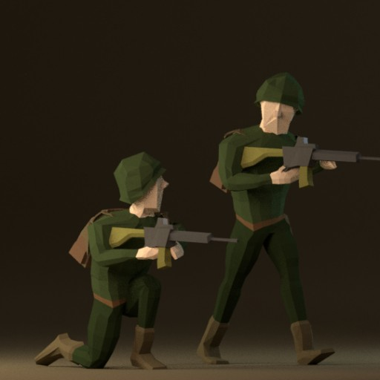
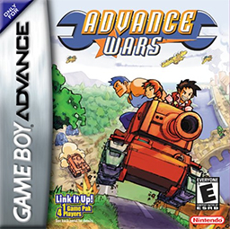
The Idea:-
The basic idea of the game is to create a fun and simplistic turn based strategy game set in an alternate history cold war.
Think Advance Wars, but 3D

Slide 5
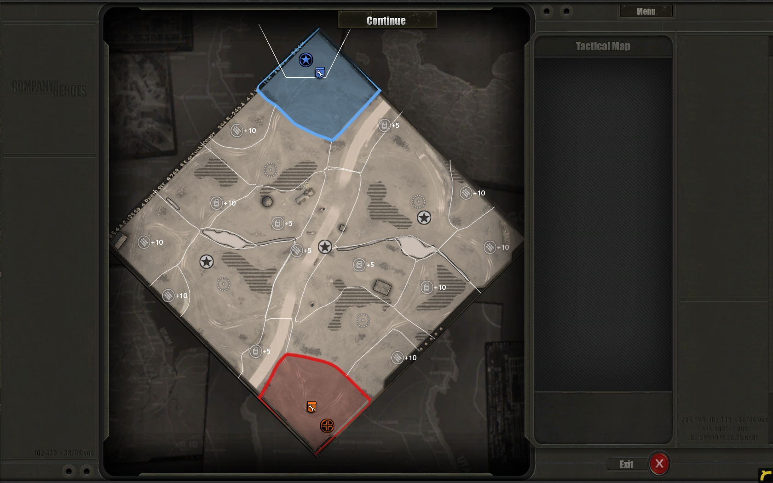
Game Structure:-
There will be three separate Maps, Large, Medium and Small. All support different amounts of players, all of which shall be set in either East or West Germany. The objectives for players is to destroy their enemies’ base and win the battle.

Slide 6
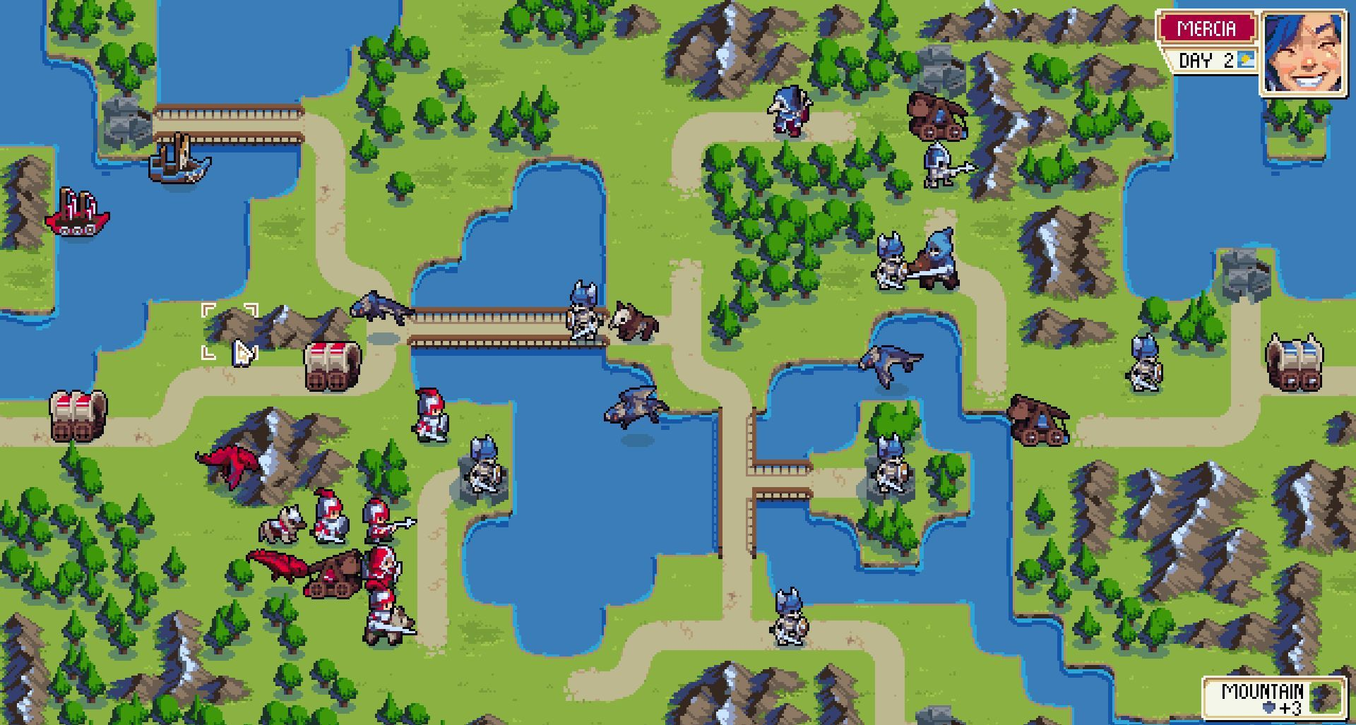
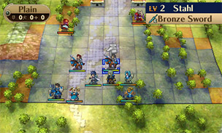
Gameplay:-
The player will be able to control the Movements and Attacks of their Units (Soldiers & Tanks) in turn destroying the oppositions Units, gaining money whilst going along an enabling the player to attain more Units.

Slide 7
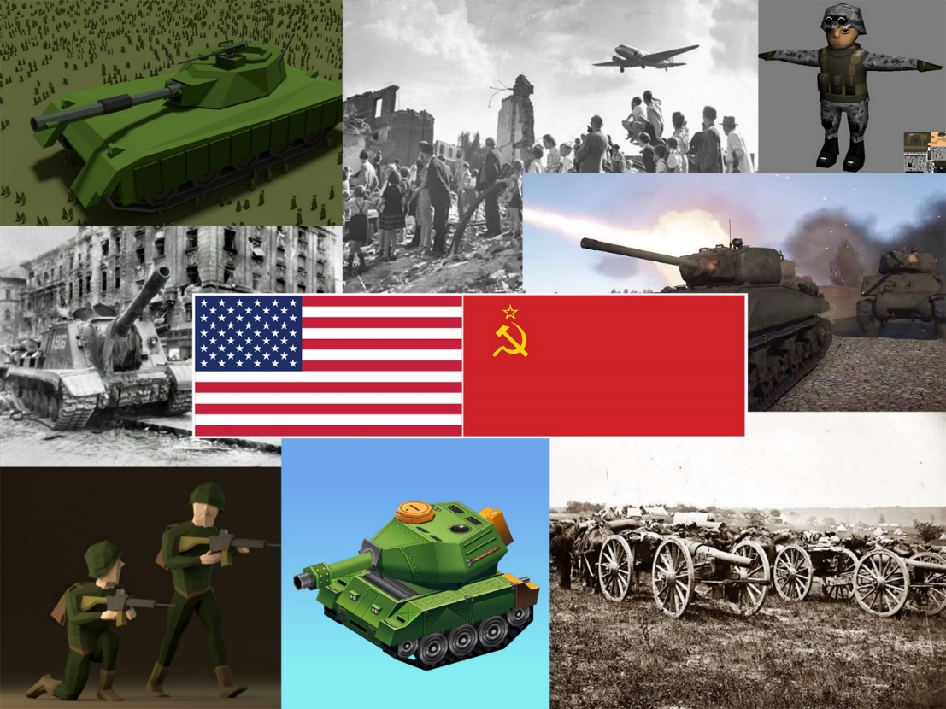
Art Style:-
3D
Low Poly
Colour Scheme Mainly Sticks to Blues, Reds and Greens

Slide 8
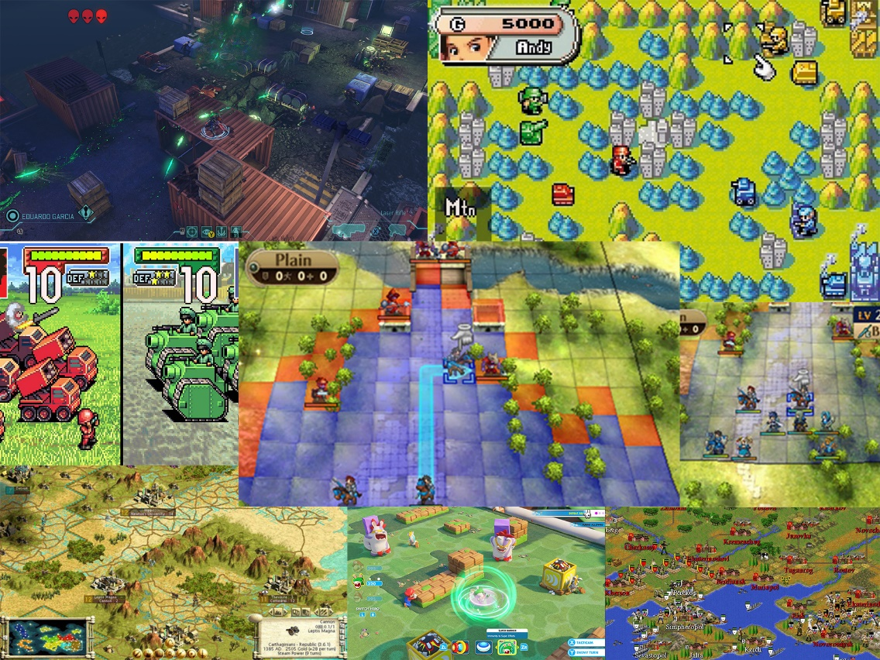
References:-
References are from similar games in terms of gameplay and or art style such as Advance Wars, Fire Emblem, Wargroove, Massive Assault etc.

